Slide 1
Introduction to image analysis
Adam Tyson
April 2018

Slide 2
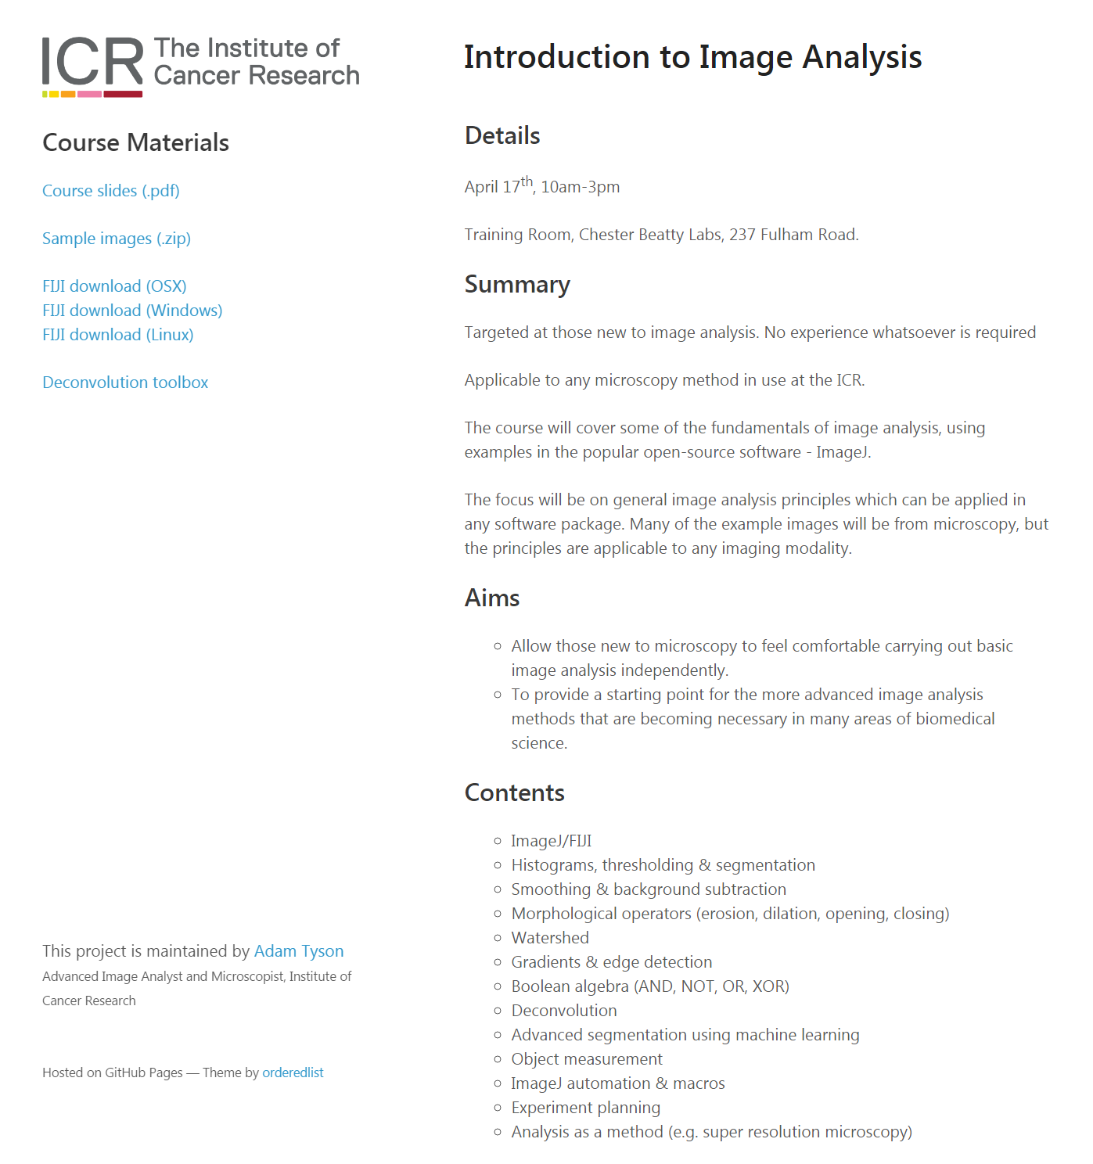
Course website
bit.ly/ICR-analysis
Slides
Sample images
Software

Slide 3
Aims
Introduction to fundamental image analysis principles
Using ImageJ/FIJI (but everything is general)
Convert biological question into computational problem

Slide 4
Aims
Introduction to fundamental image analysis principles
Using ImageJ/FIJI (but everything is general)
Convert biological question into computational problem
Disclaimer:
Some parts will be very simple. Some parts won’t.
The aim is to help you understand image analysis for your PhD/postdoc/career, not to be able to use ImageJ by the end of the day.
Like anything, requires practice.

Slide 5
Aims
Introduction to fundamental image analysis principles
Using ImageJ/FIJI (but everything is general)
Convert biological question into computational problem
Disclaimer:
Some parts will be very simple. Some parts won’t.
The aim is to help you understand image analysis for your PhD/postdoc/career, not to be able to use ImageJ by the end of the day.
Like anything, requires practice.
Email me whenever – adam.tyson@icr.ac.uk

Slide 6
Questions

Slide 7
Questions
Are you currently using microscopy or planning to?

Slide 8
Questions
Are you currently using microscopy or planning to?
Which system(s)?
Confocal/spinning disk
Multiphoton
High content (Celigo/Operetta/ImageXpress)
TIRF
Lightsheet
Any others?

Slide 9
Questions
Are you currently using microscopy or planning to?
Which system(s)?
Confocal/spinning disk
Multiphoton
High content (Celigo/Operetta/ImageXpress)
TIRF
Lightsheet
Any others?
Which analysis software?

Slide 10
Questions
Are you currently using microscopy or planning to?
Which system(s)?
Confocal/spinning disk
Multiphoton
High content (Celigo/Operetta/ImageXpress)
TIRF
Lightsheet
Any others?
Which analysis software?
A bit / no / lots of experience?

Slide 11
Questions
Are you currently using microscopy or planning to?
Which system(s)?
Confocal/spinning disk
Multiphoton
High content (Celigo/Operetta/ImageXpress)
TIRF
Lightsheet
Any others?
Which analysis software?
A bit / no / lots of experience?
Any specific aims?

Slide 12
First (and most important lesson)
Sample
preparation
Test your analysis before you acquire data!
Data
Analysis
Biological information

Slide 13
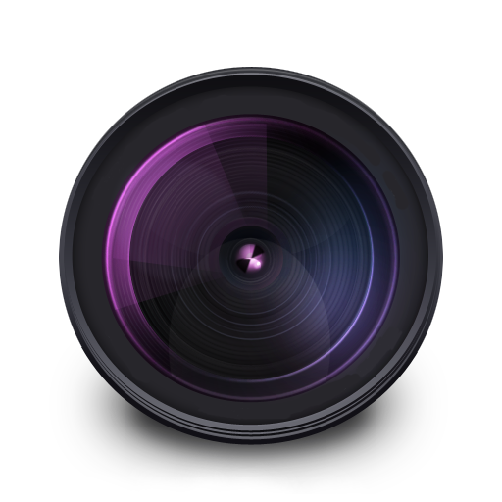
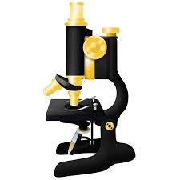










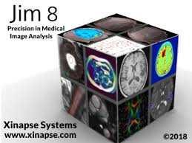






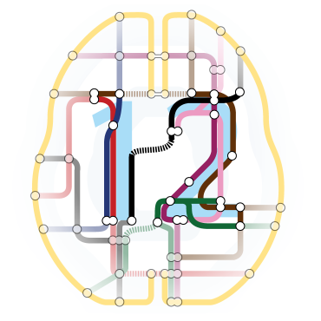
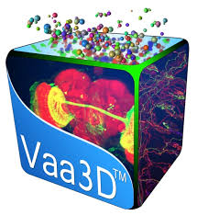



Software
Notes:
Lots of software. Not much point teaching a specific one, going to go through fundamental principles.

Slide 14
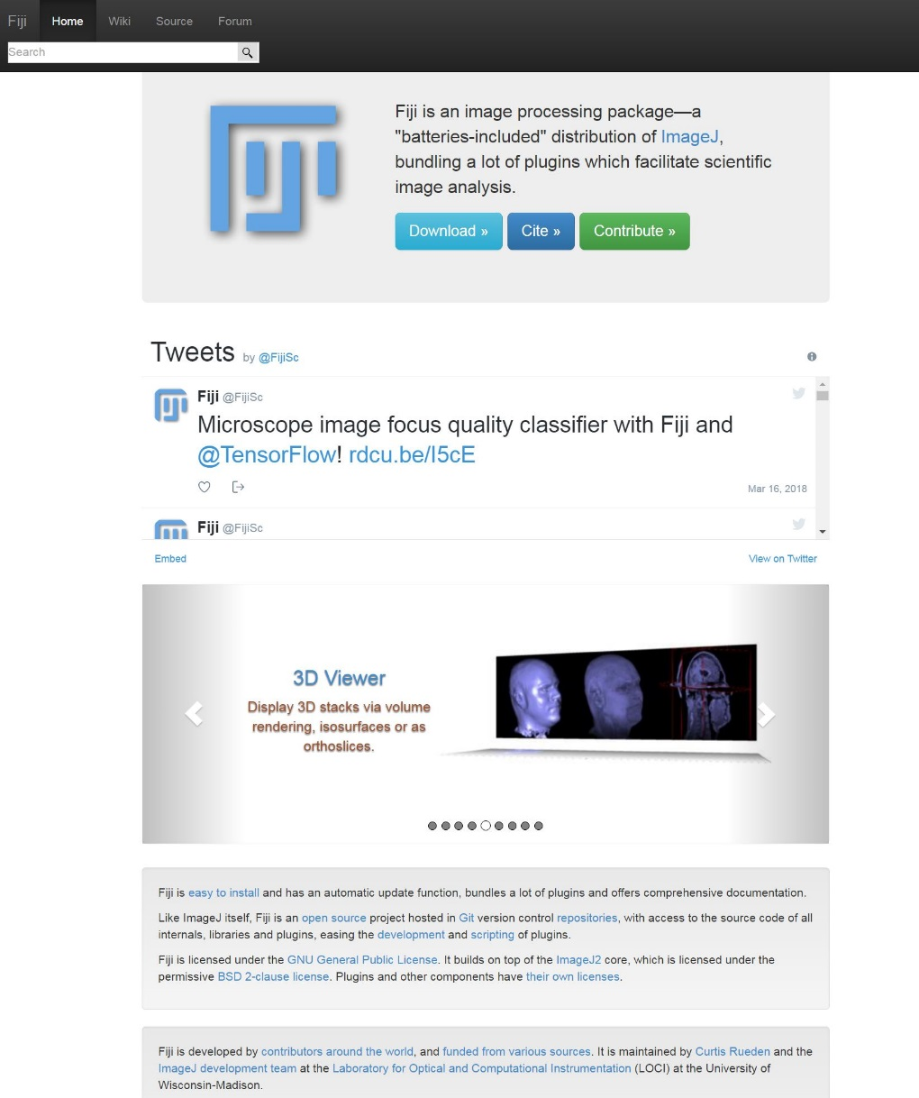
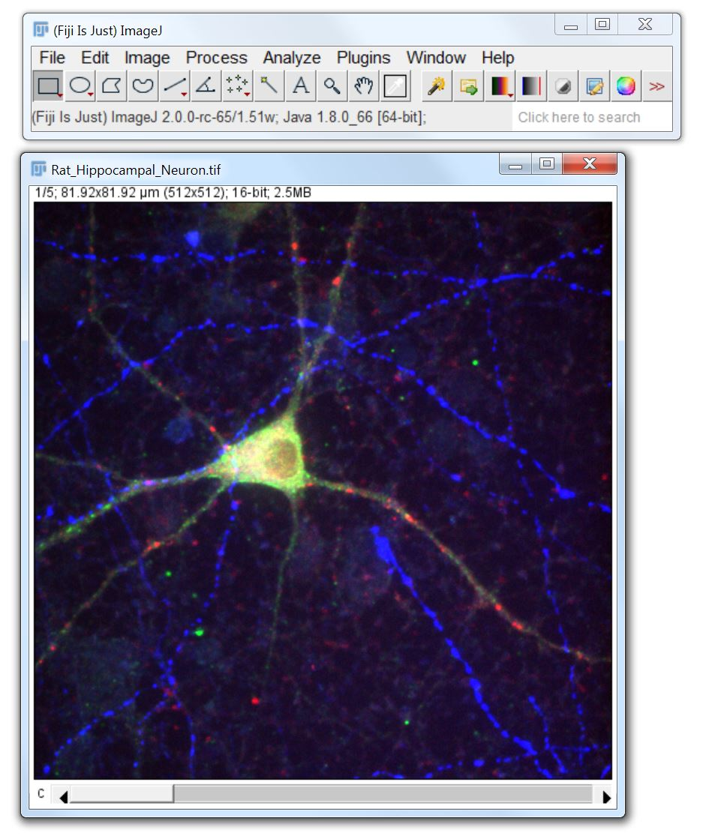
FIJI (FIJI is just ImageJ)
https://fiji.sc/
http://forum.imagej.net/

Slide 15
FIJI (FIJI is just ImageJ)
Free
Open source
Cross platform
Flexible
Huge community
https://fiji.sc/
http://forum.imagej.net/

Slide 16
Why computational image analysis?
Notes:
Lots of data, can’t analyse manually. Inspection of data doesn’t help when comparing lots of studies.

Slide 17
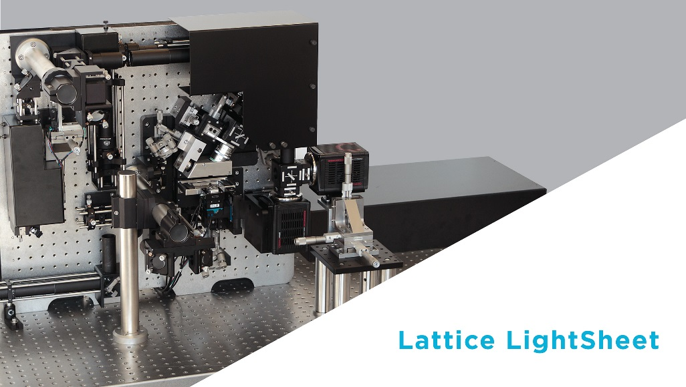
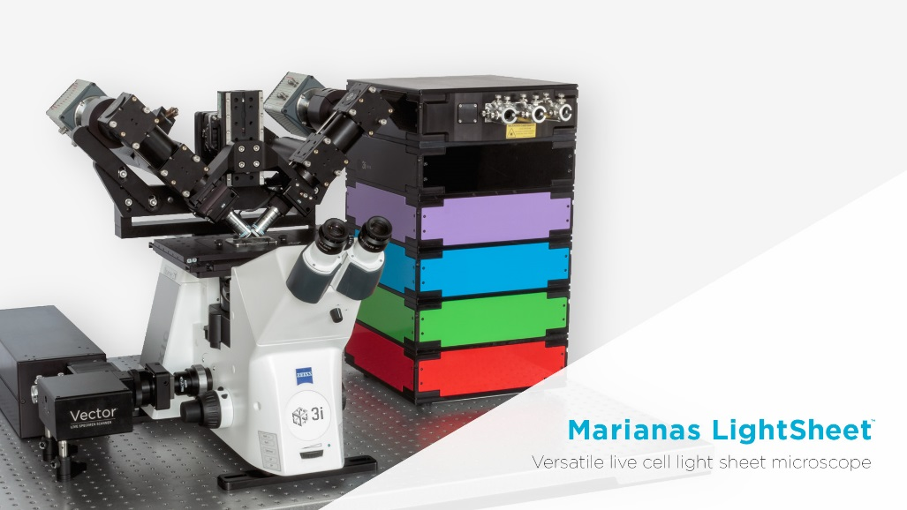
Why computational image analysis?
Quantity of data (TB’s per day)
Notes:
Lots of data, can’t analyse manually. Inspection of data doesn’t help when comparing lots of studies.

Slide 18
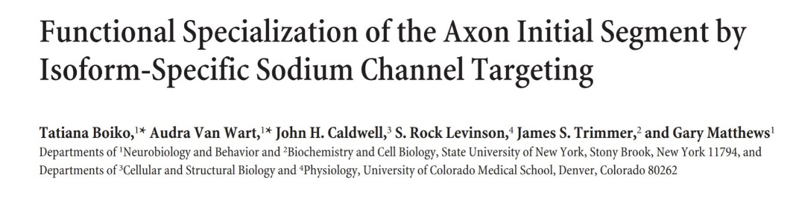
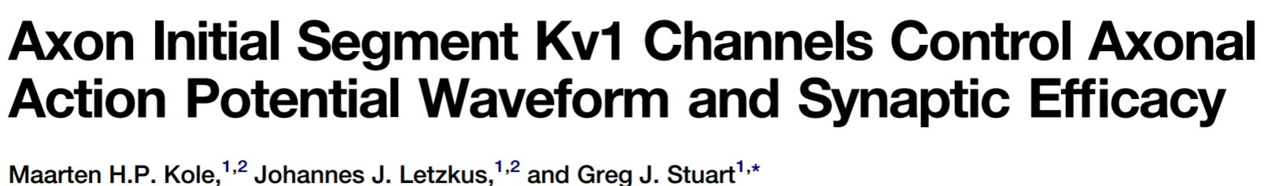
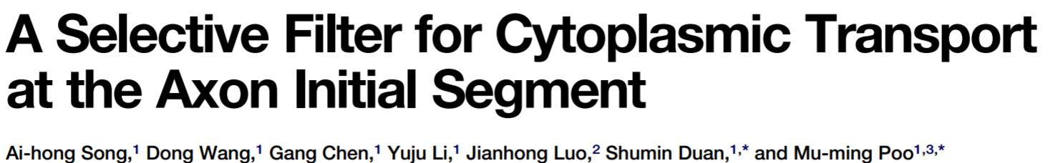
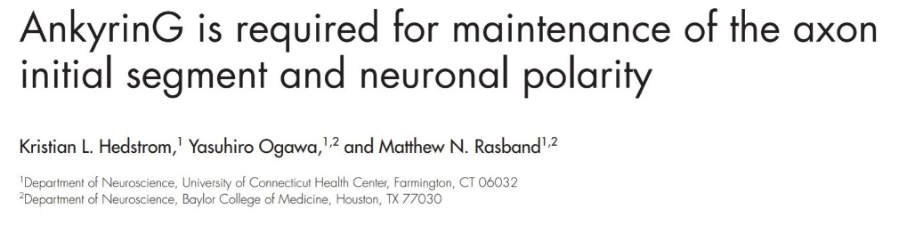
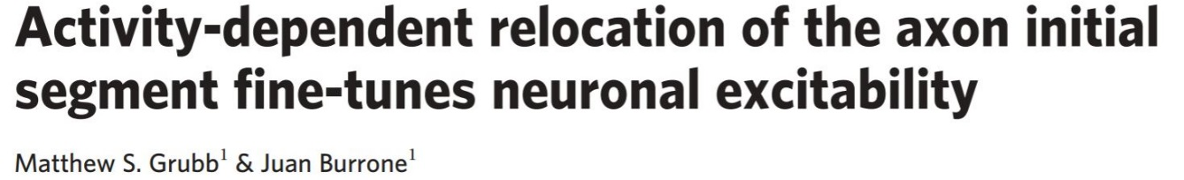
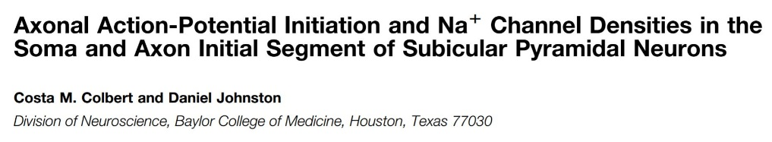
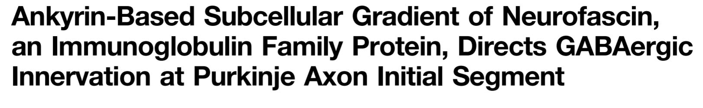
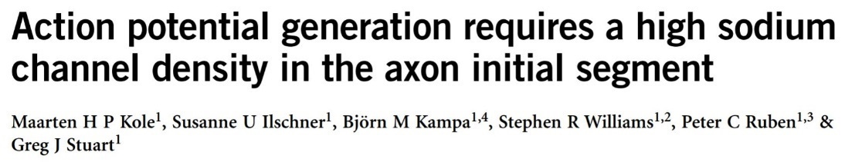
Why computational image analysis?
Quantity of data (TB’s per day)
Reproducibility, comparison
Notes:
Lots of data, can’t analyse manually. Inspection of data doesn’t help when comparing lots of studies.

Slide 19
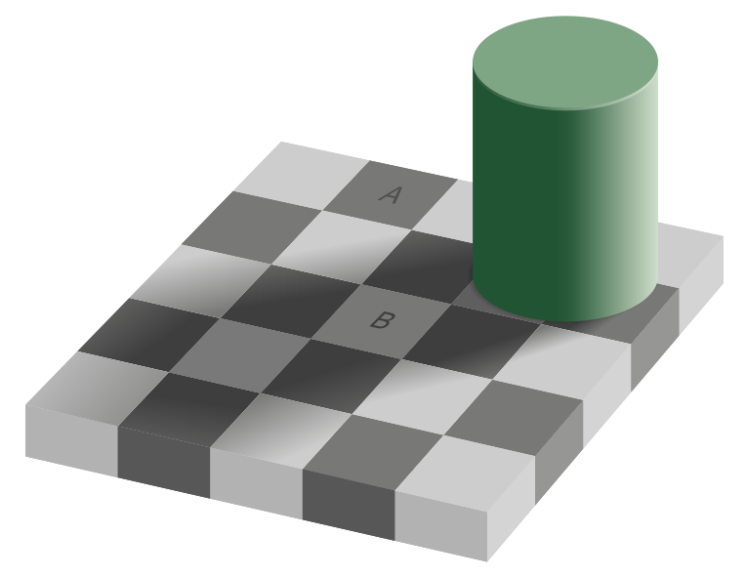
Why computational image analysis?
Visual system relies heavily on context and relative changes.
Checker shadow illusion, Edward Adelson 1995.
Notes:
Most importantly – eye is very easy to fool.

Slide 20

Why computational image analysis?
Visual system relies heavily on context and relative changes.
Checker shadow illusion, Edward Adelson 1995.
Notes:
Most importantly – eye is very easy to fool.

Slide 21

Why computational image analysis?
Visual system relies heavily on context and relative changes.
Checker shadow illusion, Edward Adelson 1995.
Jastrow illusion, Joseph Jastrow (and others), 1892.
Notes:
Most importantly – eye is very easy to fool.

Slide 22
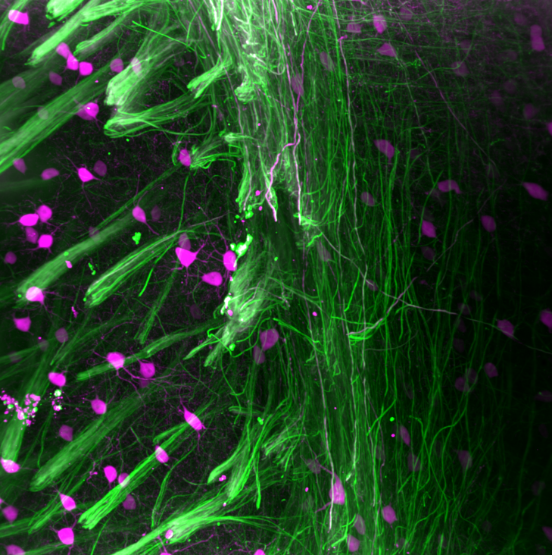
Nearly all microscopy images aren’t colour

Slide 23
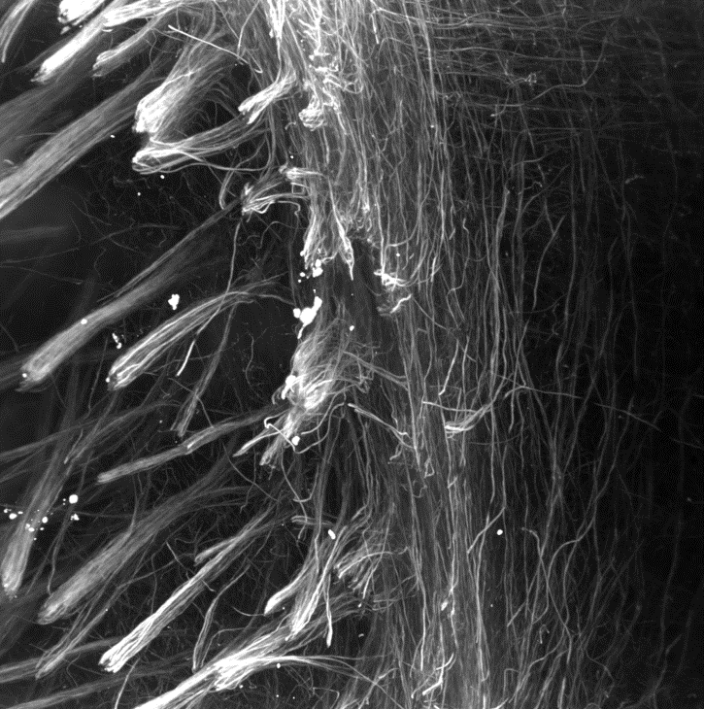
Nearly all microscopy images aren’t colour

Slide 24
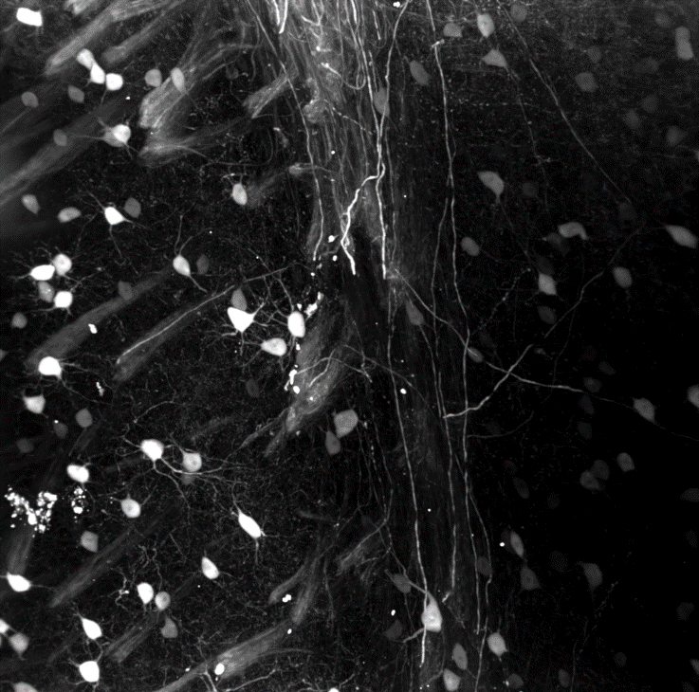
Nearly all microscopy images aren’t colour

Slide 25

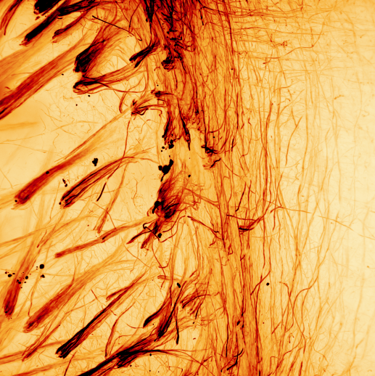
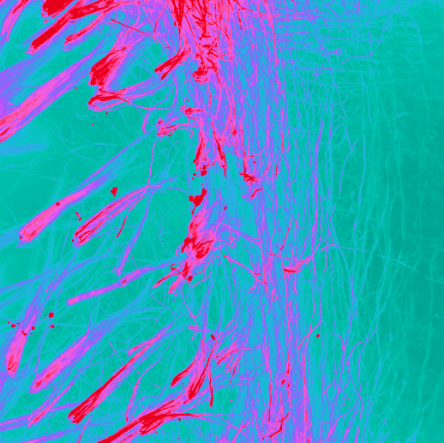
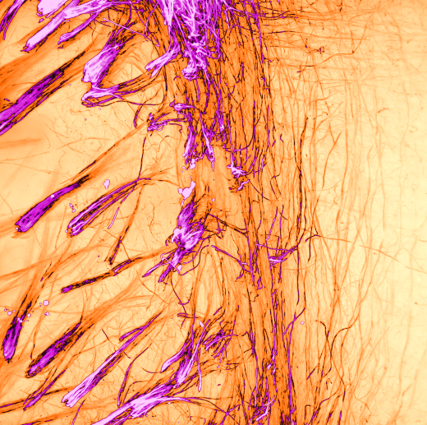
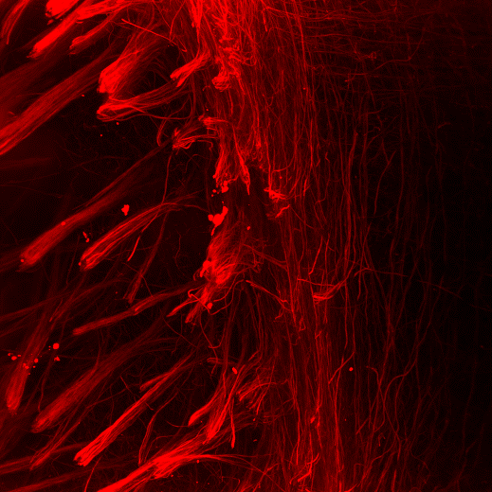
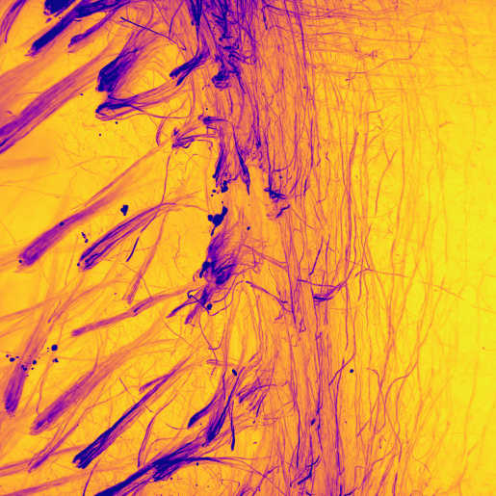
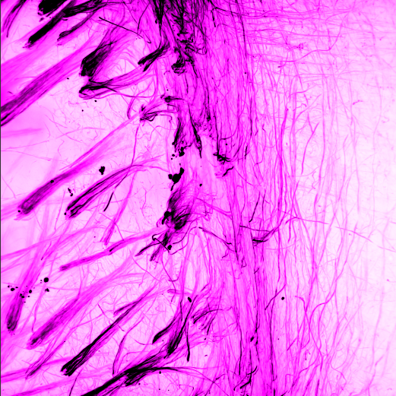
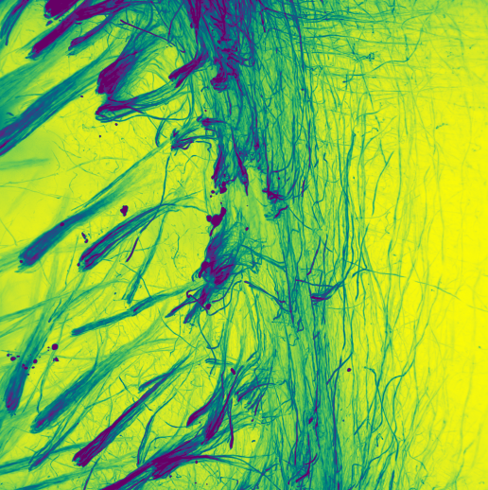
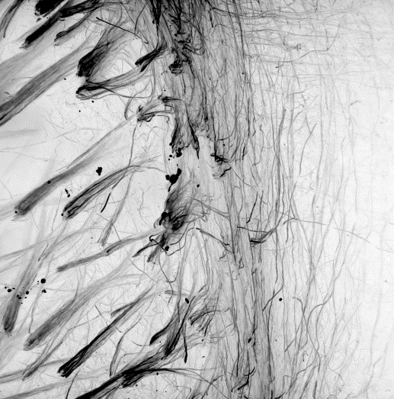
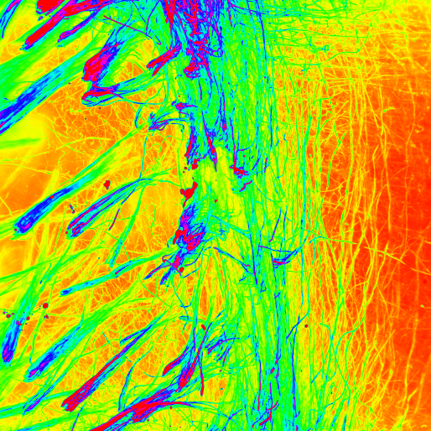
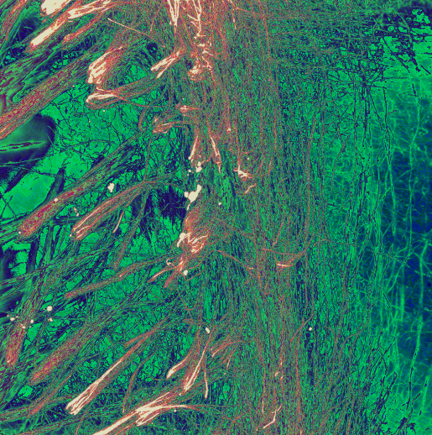
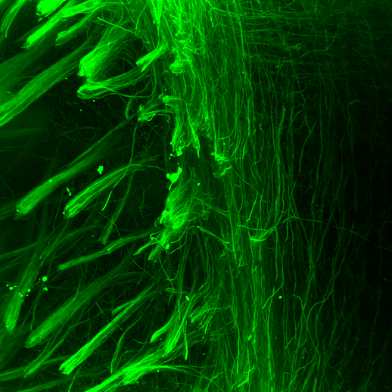
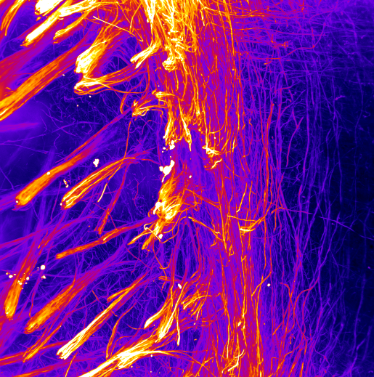
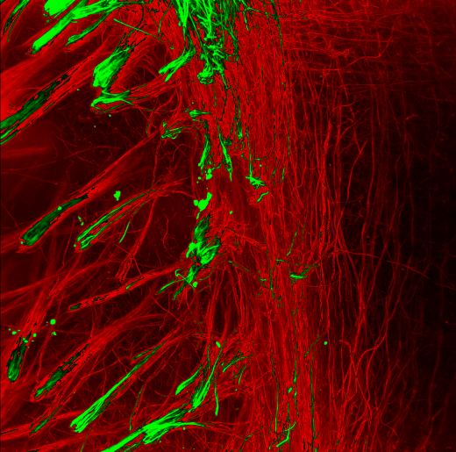
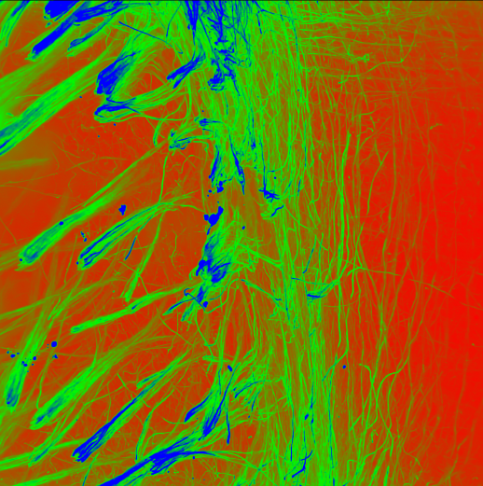
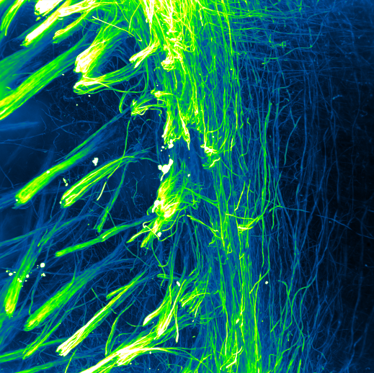
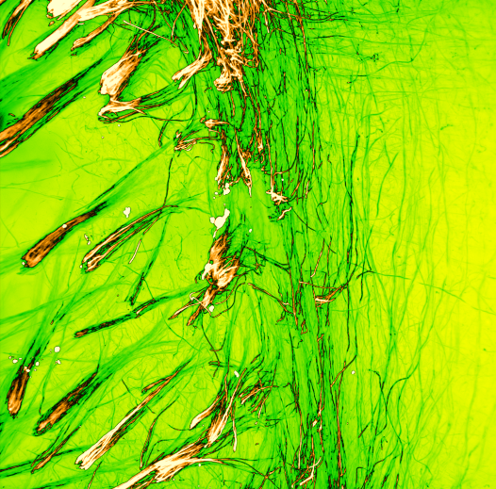
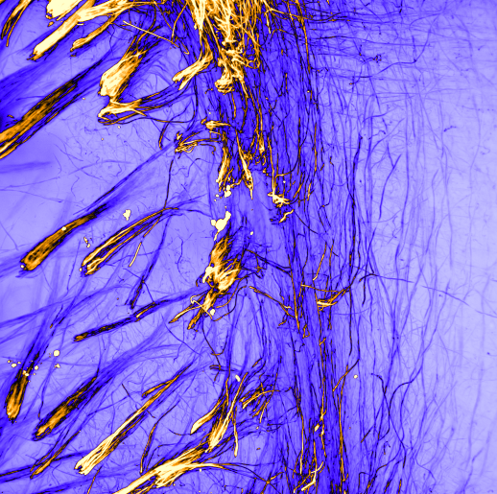
Lookup tables (LUTs)

Slide 26
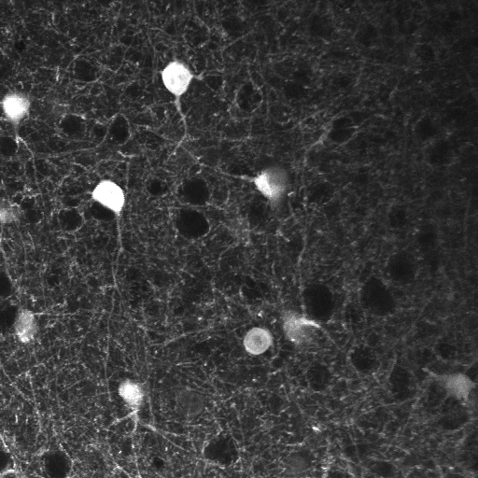
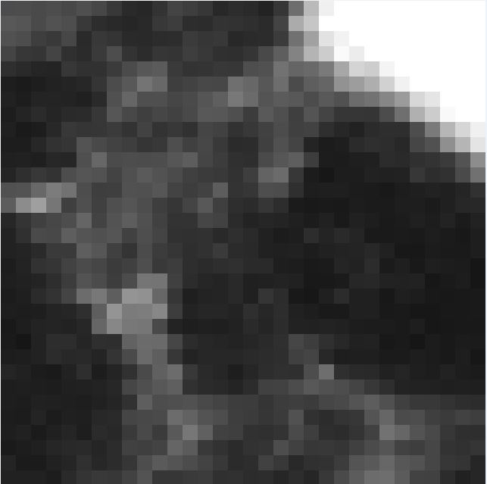

Images are arrays of numbers
78 | 64 | 71 | 57 | 43 | 44
86 | 93 | 69 | 60 | 48 | 46
75 | 64 | 57 | 59 | 55 | 62
70 | 65 | 69 | 85 | 56 | 54
54 | 68 | 88 | 63 | 46 | 43
51 | 51 | 74 | 66 | 43 | 35
Notes:
Important to remember that images are just arrays of numbers, and all image processing is mathematical operations upon these numbers.

Slide 27
More complicated images are still arrays of numbers
2D
78 | 64 | 71 | 57 | 43 | 44
86 | 93 | 69 | 60 | 48 | 46
75 | 64 | 57 | 59 | 55 | 62
70 | 65 | 69 | 85 | 56 | 54
54 | 68 | 88 | 63 | 46 | 43
51 | 51 | 74 | 66 | 43 | 35
Notes:
Important to remember that images are just arrays of numbers, and all image processing is mathematical operations upon these numbers.

Slide 28
More complicated images are still arrays of numbers
2D
Notes:
Important to remember that images are just arrays of numbers, and all image processing is mathematical operations upon these numbers.

Slide 29
More complicated images are still arrays of numbers
RGB
2D
Notes:
Important to remember that images are just arrays of numbers, and all image processing is mathematical operations upon these numbers.

Slide 30
More complicated images are still arrays of numbers
RGB
2D
3D
Notes:
Important to remember that images are just arrays of numbers, and all image processing is mathematical operations upon these numbers.

Slide 31
More complicated images are still arrays of numbers
RGB
2D
Time-lapse
3D
Notes:
Important to remember that images are just arrays of numbers, and all image processing is mathematical operations upon these numbers.

Slide 32
More complicated images are still arrays of numbers
RGB
2D
Time-lapse
3D RGB
3D
Notes:
Important to remember that images are just arrays of numbers, and all image processing is mathematical operations upon these numbers.

Slide 33
More complicated images are still arrays of numbers
RGB
2D
Time-lapse
3D RGB
3D
3D time-lapse
Notes:
Important to remember that images are just arrays of numbers, and all image processing is mathematical operations upon these numbers.

Slide 34
More complicated images are still arrays of numbers
RGB
2D
Time-lapse
3D RGB
3D
3D time-lapse
3D RGB time-lapse
Notes:
Important to remember that images are just arrays of numbers, and all image processing is mathematical operations upon these numbers.

Slide 35
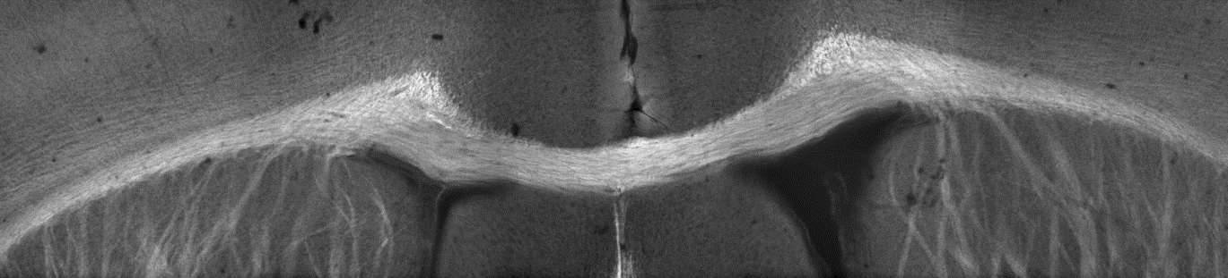


Image processing vs analysis
Notes:
During image analysis, lots of the work will be image processing, i.e. getting the image ready to be analysed.

Slide 36
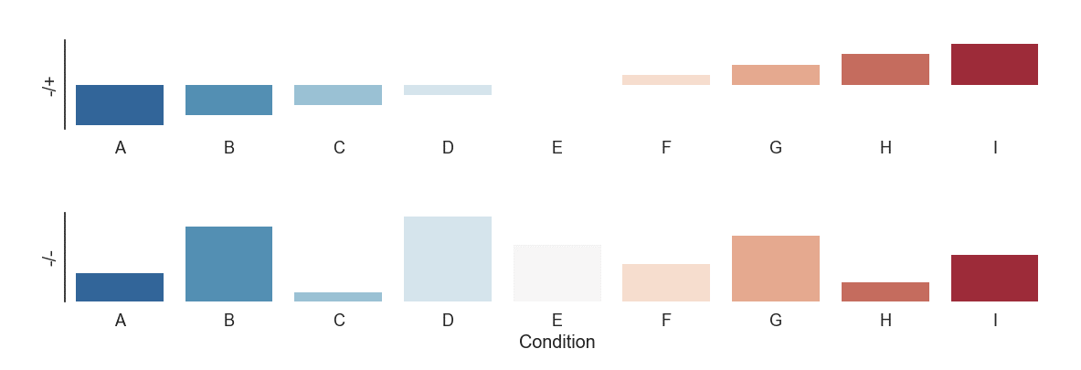
Image processing vs analysis
Volume
Shape
Texture
Notes:
During image analysis, lots of the work will be image processing, i.e. getting the image ready to be analysed.

Slide 37
Image processing vs analysis
Volume
Shape
Texture
Notes:
During image analysis, lots of the work will be image processing, i.e. getting the image ready to be analysed.

Slide 38
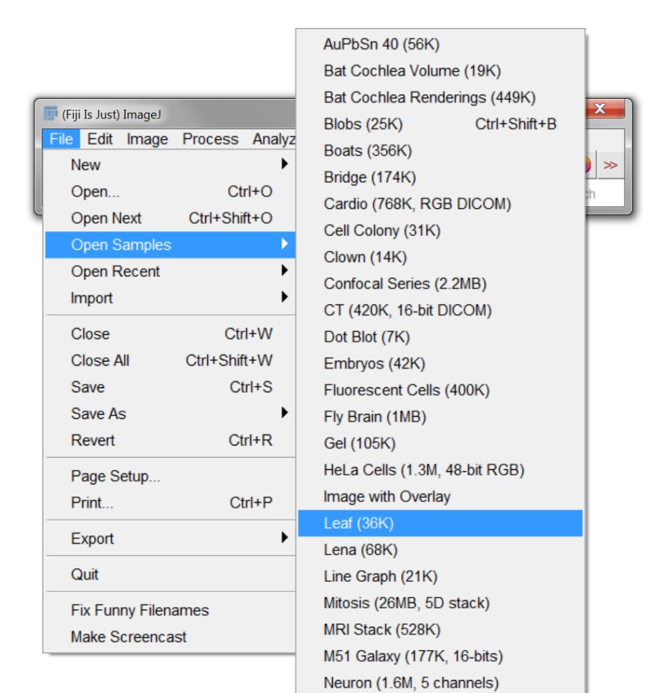
Histogram
Open any sample image
Notes:
Histogram shows how many pixels are of each possible intensity,

Slide 39
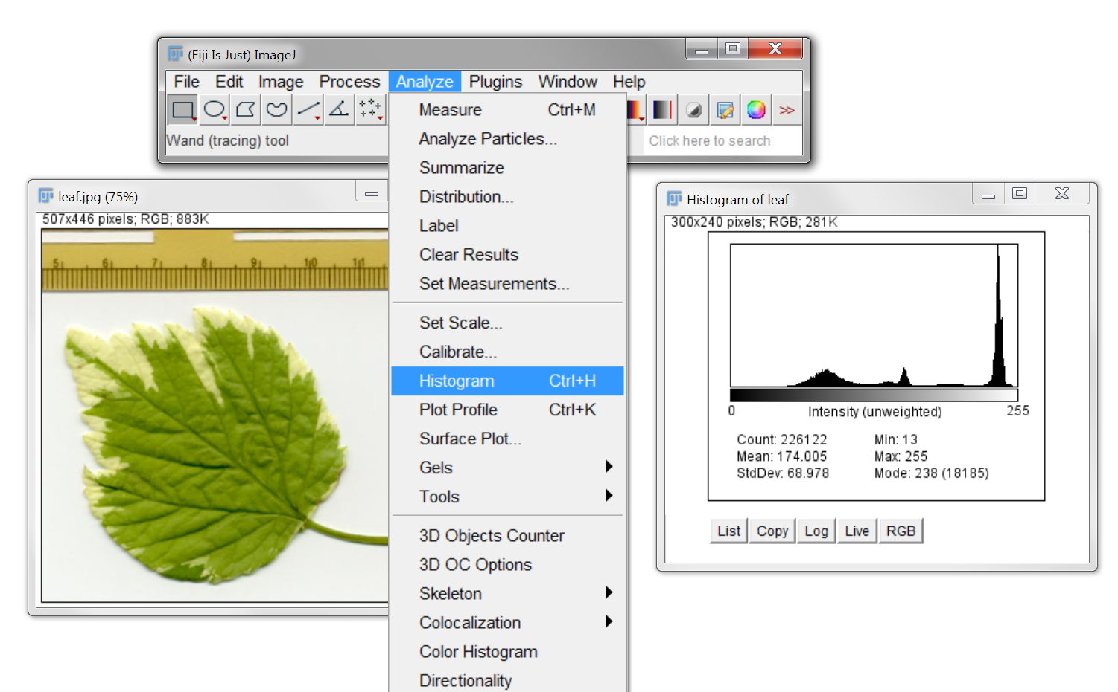
Histogram
Open any sample image
Open histogram
Notes:
Histogram shows how many pixels are of each possible intensity,

Slide 40
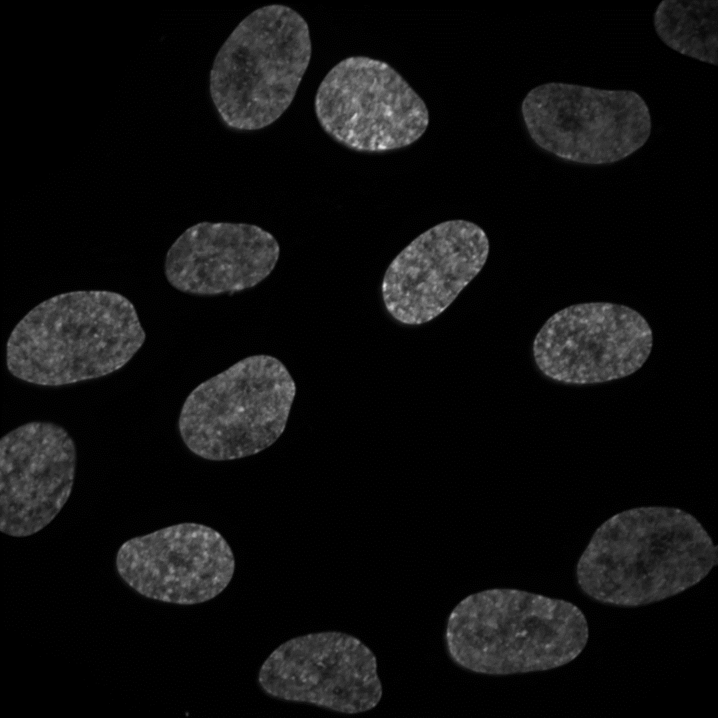
Thresholding
Threshold (κ)
Notes:
To perform a simple threshold, pick a point on the histogram. All pixels below a point belong to one class, and all pixels above it belong to the other.

Slide 41
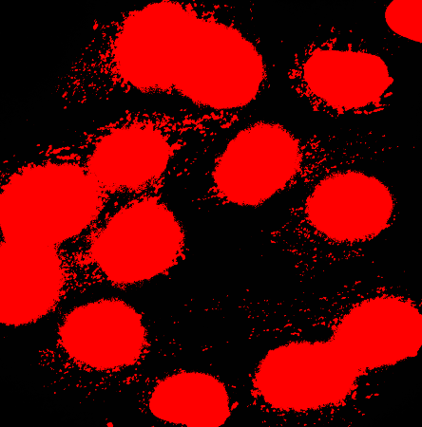

Thresholding
$$k$$
Notes:
Choosing the right value for this threshold is obviously important. Too high, and features of interest won’t be detected. Too low, and other structures in the image will be detected too.

Slide 42
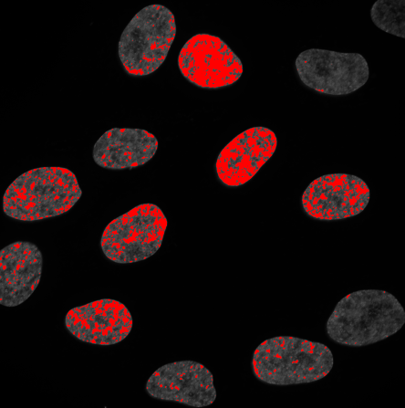

Thresholding
$$k$$
$$k$$
Notes:
Choosing the right value for this threshold is obviously important. Too high, and features of interest won’t be detected. Too low, and other structures in the image will be detected too.

Slide 43
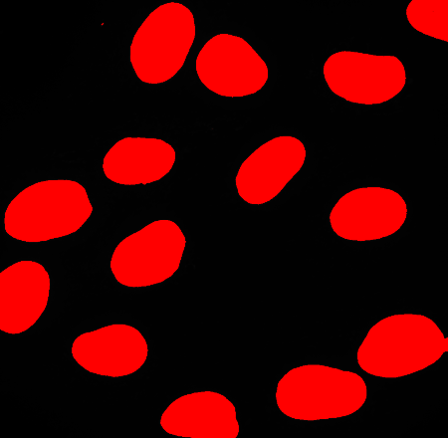

Thresholding
$$k$$
$$k$$
$$k$$
Notes:
Choosing the right value for this threshold is obviously important. Too high, and features of interest won’t be detected. Too low, and other structures in the image will be detected too.

Slide 44
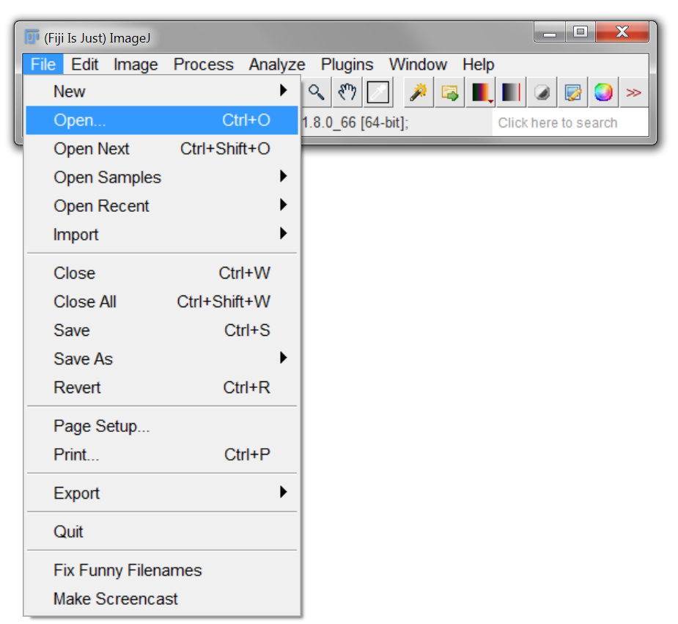
Thresholding – try it out
Open DAPI.tif

Slide 45

Thresholding – try it out
Open DAPI.tif
Threshold

Slide 46

Manual threshold - problems
DAPI.tif

Slide 47

Manual threshold - problems
DAPI.tif
DAPI_2.tif

Slide 48

Automatic thresholding – Equal masses
Ideal case
$$k$$

Slide 49


Automatic thresholding – Equal masses
Ideal case
Real case
$$k$$
$$k$$

Slide 50




Automatic thresholding – Otsu’s method
Minimise within class variance (σ_{W})
Maximise between class variance (σ_{B})
$$k$$
Otsu (1979) IEEE Transactions on Systems, Man and Cybernetics. Vol SMC-9, No 1, p62

Slide 51

Automatic thresholding – Otsu’s method
Minimise within class variance (σ_{W})
Maximise between class variance (σ_{B})
$$k$$
Otsu (1979) IEEE Transactions on Systems, Man and Cybernetics. Vol SMC-9, No 1, p62

Slide 52

Automatic thresholding – Otsu’s method
Minimise within class variance (σ_{W})
Maximise between class variance (σ_{B})
$$k$$
$$k$$
Otsu (1979) IEEE Transactions on Systems, Man and Cybernetics. Vol SMC-9, No 1, p62

Slide 53
Unimodal thresholding – Rosin’s method
Use shape of distribution to find threshold
Rosin (2001) Pattern Recognition. Vol 34, No 11, p2083

Slide 54

Unimodal thresholding – Rosin’s method
Use shape of distribution to find threshold
$$k$$
Rosin (2001) Pattern Recognition. Vol 34, No 11, p2083

Slide 55

Try it out – Otsu’s method
Otsu (1979) IEEE Transactions on Systems, Man and Cybernetics. Vol SMC-9, No 1, p62

Slide 56

Many, many other methods
Kapur et al. (1985) Graphical Models and Image Processing Vol 29, No 3, p273

Slide 57


Not always that simple …
Open DAPI_3.tif
Pick a threshold
vs

Slide 58

Background subtraction – e.g. vignetting
Sample

Slide 59
Background subtraction – e.g. vignetting
Sample
Microscope

Slide 60

Background subtraction – e.g. vignetting
Sample
Microscope
Image

Slide 61
Background subtraction – e.g. vignetting

Slide 62
Background subtraction – e.g. vignetting

Slide 63
Background subtraction – e.g. vignetting

Slide 64
Background subtraction – e.g. vignetting
How to calculate??

Slide 65
Estimate background – Gaussian smoothing
Seems arbitrary, but smoothing is often a key step in image processing

Slide 66

Estimate background – Gaussian smoothing
Seems arbitrary, but smoothing is often a key step in image processing

Slide 67
Estimate background – Gaussian smoothing
Seems arbitrary, but smoothing is often a key step in image processing
Try a value of 200 pixels

Slide 68

Estimate background – Gaussian smoothing
May need to adjust brightness

Slide 69

Estimate background – Gaussian smoothing
May need to adjust brightness

Slide 70


Estimate background

Slide 71

Estimate background

Slide 72

Now try thresholding

Slide 73


Now try thresholding
Better, but not great

Slide 74

Morphological operations
Processing of (usually binary) images based on shape

Slide 75

Morphological operations
Try on the previous example
Thresholded

Slide 76

Morphological operations
Try on the previous example
Thresholded
Eroded

Slide 77

Morphological operations
Try on the previous example
Dilated and closed
Thresholded
Eroded

Slide 78

Watershed – separate objects
From the previous example
Notes:
Basic implementation in ImageJ – but often requires a lot of tweaking if you don’t have two perfectly circular objects.

Slide 79

Watershed – separate objects
From the previous example
Notes:
Basic implementation in ImageJ – but often requires a lot of tweaking if you don’t have two perfectly circular objects.

Slide 80

Watershed – separate objects
From the previous example
Notes:
Basic implementation in ImageJ – but often requires a lot of tweaking if you don’t have two perfectly circular objects.

Slide 81

Watershed

Slide 82

Watershed

Slide 83
Watershed

Slide 84
Watershed
Negative intensity profile
Distance transform

Slide 85
Watershed
Negative intensity profile
Distance transform

Slide 86
Watershed
Negative intensity profile
Distance transform

Slide 87
Watershed
Negative intensity profile
Distance transform

Slide 88
Watershed
Negative intensity profile
Distance transform

Slide 89
Watershed
Negative intensity profile
Distance transform
Watershed

Slide 90



Filters - Gaussian
Large kernel (200 pix)
Correct inhomogeneous illumination

Slide 91


Filters - Gaussian
Small kernel (8 pix)
Smooth intensity variations for thresholding

Slide 92


Filters - Gaussian
Open foci.tif & try thresholding
Apply Gaussian smoothing (use preview) & try again

Slide 93

Filters - Gaussian
Open foci.tif & try thresholding
Apply Gaussian smoothing (use preview) & try again
vs

Slide 94


Filters - Gradient
Edge detection

Slide 95
Filters - Gradient
Edge detection
Approximate derivative:
The Sobel operator

Slide 96

Filters - Gradient
Edge detection
Approximate derivative:
The Sobel operator

Slide 97

Filters - Gradient
Edge detection
Approximate derivative:
The Sobel operator

Slide 98

Filters - Gradient

Slide 99









Filters - Gradient

Slide 100

Filters - Gradient
Combine

Slide 101

Filters - Gradient
Combine

Slide 102
Boolean image mathematics

Slide 103
Boolean image mathematics
AND

Slide 104
Boolean image mathematics
AND
OR

Slide 105
Boolean image mathematics
AND
OR
XOR

Slide 106


Boolean image mathematics - masking

Slide 107


Boolean image mathematics - masking
PV.tif
PV_DAPI.tif

Slide 108
Boolean image mathematics - masking
PV.tif
PV_DAPI.tif
PV_seg.tif

Slide 109

Boolean image mathematics - masking
PV.tif
PV_DAPI.tif
PV_seg.tif

Slide 110
First (and most important lesson) – again!
Sample
preparation
Test your analysis before you acquire data!
Data
Analysis
Biological information

Slide 111
Deconvolution
Sample

Slide 112
Deconvolution
Sample
PSF

Slide 113
Deconvolution
Sample
Blurred
PSF

Slide 114
Deconvolution
Sample
Blurred
PSF
Noise

Slide 115
Deconvolution
Sample
Blurred
Blurred & noisy
PSF
Noise

Slide 116
Deconvolution
Sample
Blurred
Blurred & noisy
PSF
Noise
?

Slide 117
Deconvolution – how?
Constrained iterative deconvolution
e.g. Richardson-Lucy
Lucy (1974) The Astronomical Journal. Vol 79, No 6 p745
Richardson (1972) Journal of the Optical Society of America, Vol 62, No 1, p55

Slide 118
Deconvolution – how?
Image
Constrained iterative deconvolution
e.g. Richardson-Lucy
Operation
Raw Image
Lucy (1974) The Astronomical Journal. Vol 79, No 6 p745
Richardson (1972) Journal of the Optical Society of America, Vol 62, No 1, p55

Slide 119
Deconvolution – how?
Image
Constrained iterative deconvolution
e.g. Richardson-Lucy
Operation
Raw Image
Estimate
Lucy (1974) The Astronomical Journal. Vol 79, No 6 p745
Richardson (1972) Journal of the Optical Society of America, Vol 62, No 1, p55

Slide 120
Deconvolution – how?
PSF
Image
Constrained iterative deconvolution
e.g. Richardson-Lucy
Operation
Convolve with PSF
Raw Image
Estimate
Lucy (1974) The Astronomical Journal. Vol 79, No 6 p745
Richardson (1972) Journal of the Optical Society of America, Vol 62, No 1, p55

Slide 121
Deconvolution – how?
PSF
Image
Constrained iterative deconvolution
e.g. Richardson-Lucy
Operation
Convolve with PSF
Convolved
estimate
Raw Image
Estimate
Lucy (1974) The Astronomical Journal. Vol 79, No 6 p745
Richardson (1972) Journal of the Optical Society of America, Vol 62, No 1, p55

Slide 122
Deconvolution – how?
PSF
Image
Constrained iterative deconvolution
e.g. Richardson-Lucy
Operation
Convolve with PSF
Convolved
estimate
Raw Image
Estimate
Compare with raw
Raw Image
Lucy (1974) The Astronomical Journal. Vol 79, No 6 p745
Richardson (1972) Journal of the Optical Society of America, Vol 62, No 1, p55

Slide 123
Deconvolution – how?
PSF
Image
Constrained iterative deconvolution
e.g. Richardson-Lucy
Operation
Convolve with PSF
Convolved
estimate
Raw Image
Estimate
Compare with raw
Improve estimate
Raw Image
Lucy (1974) The Astronomical Journal. Vol 79, No 6 p745
Richardson (1972) Journal of the Optical Society of America, Vol 62, No 1, p55

Slide 124
Deconvolution – how?
PSF
Image
Constrained iterative deconvolution
e.g. Richardson-Lucy
Operation
Convolve with PSF
Convolved
estimate
Raw Image
Estimate
Deconvolved
Compare with raw
Improve estimate
Raw Image
Lucy (1974) The Astronomical Journal. Vol 79, No 6 p745
Richardson (1972) Journal of the Optical Society of America, Vol 62, No 1, p55

Slide 125

Deconvolution – try it out
DeconvolutionLab2
Sage et al. (2017) Methods. Vol 115, p28
http://bigwww.epfl.ch/deconvolution/deconvolutionlab2/

Slide 126
Deconvolution – BUT
DeconvolutionLab2
Sage et al. (2017) Methods. Vol 115, p28
http://bigwww.epfl.ch/deconvolution/deconvolutionlab2/

Slide 127

Deconvolution – BUT
DeconvolutionLab2
Plugin is free, but must be manually installed
Download .jar file and copy into plugins folder
Sage et al. (2017) Methods. Vol 115, p28
http://bigwww.epfl.ch/deconvolution/deconvolutionlab2/

Slide 128

Deconvolution – try it out
DeconvolutionLab2
Sage et al. (2017) Methods. Vol 115, p28
http://bigwww.epfl.ch/deconvolution/deconvolutionlab2/

Slide 129
Deconvolution – try it out
DeconvolutionLab2
Drag and drop
CElegans-FITC.tif
PSF-CElegans-FITC.tif
C. Elegans embryo - microtubules
Sage et al. (2017) Methods. Vol 115, p28
http://bigwww.epfl.ch/deconvolution/deconvolutionlab2/

Slide 130

Deconvolution – try it out
DeconvolutionLab2
Drag and drop
CElegans-FITC.tif
PSF-CElegans-FITC.tif
C. Elegans embryo - microtubules
Sage et al. (2017) Methods. Vol 115, p28
http://bigwww.epfl.ch/deconvolution/deconvolutionlab2/

Slide 131
Deconvolution – try it out (hopefully)
Deconvolution is computationally intense – may be very slow on these machines
http://bigwww.epfl.ch/deconvolution/deconvolutionlab2/

Slide 132

Deconvolution – try it out (hopefully)
Deconvolution is computationally intense – may be very slow on these machines
Try “Regularized Inverse Filter”
http://bigwww.epfl.ch/deconvolution/deconvolutionlab2/

Slide 133

Deconvolution – try it out (hopefully)
Deconvolution is computationally intense – may be very slow on these machines
Try “Regularized Inverse Filter”
http://bigwww.epfl.ch/deconvolution/deconvolutionlab2/

Slide 134
Deconvolution – try it out (hopefully)
Deconvolution is computationally intense – may be very slow on these machines
Try “Regularized Inverse Filter”
Richardson-Lucy – start with 10 iterations - compare
http://bigwww.epfl.ch/deconvolution/deconvolutionlab2/

Slide 135
Deconvolution – notes

Slide 136
Deconvolution – notes
GIGA – Garbage In, Garbage Out

Slide 137
Deconvolution – notes
GIGA – Garbage In, Garbage Out
Not always necessary

Slide 138
Deconvolution – notes
GIGA – Garbage In, Garbage Out
Not always necessary
Only an estimate of fluorophore distribution

Slide 139
Deconvolution – notes
GIGA – Garbage In, Garbage Out
Not always necessary
Only an estimate of fluorophore distribution
100’s of algorithms and options – try them out

Slide 140
Deconvolution – notes
GIGA – Garbage In, Garbage Out
Not always necessary
Only an estimate of fluorophore distribution
100’s of algorithms and options – try them out
Can be very slow

Slide 141
Deconvolution – notes
GIGA – Garbage In, Garbage Out
Not always necessary
Only an estimate of fluorophore distribution
100’s of algorithms and options – try them out
Can be very slow
Requires a good quality measured PSF (estimated PSF’s can work for standard microscopes)
Routine to measure each day on light-sheet systems (e.g. lattice)

Slide 142
Machine Learning
Often intensity alone can’t be used for segmentation
Need “context”
Train the computer to “recognize” structures

Slide 143

Machine Learning
Open CHO.tif
Often intensity alone can’t be used for segmentation
Need “context”
Train the computer to “recognize” structures

Slide 144

Machine Learning
Try to threshold!

Slide 145

Machine Learning – Trainable Weka Segmentation

Slide 146

Machine Learning – Trainable Weka Segmentation

Slide 147

Machine Learning – Trainable Weka Segmentation

Slide 148






Machine Learning – Trainable Weka Segmentation
Lots of training data

Slide 149


Machine Learning – Trainable Weka Segmentation
Lots of training data
Choose features carefully

Slide 150
Machine Learning – Trainable Weka Segmentation
Lots of training data
Choose features carefully
Will be slow!

Slide 151
Machine Learning – Trainable Weka Segmentation
Lots of training data
Choose features carefully
Will be slow!
iLastik

Slide 152
Analysis (rather than processing)
Measure segmented objects

Slide 153


Analysis (rather than processing)
Measure segmented objects

Slide 154

Analysis (rather than processing)
Measure segmented objects

Slide 155
Analysis

Slide 156

Analysis
Measure other objects
Draw, then measure

Slide 157

Analysis
Measure other objects
Draw, then measure

Slide 158

Analysis
Multiple objects – ROI manager

Slide 159
Analysis
Multiple objects – ROI manager

Slide 160

Analysis
Multiple objects – ROI manager

Slide 161
Analysis – 3D

Slide 162

Analysis – 3D

Slide 163


Analysis – 3D

Slide 164
Analysis – 3D

Slide 165
Macros - record
Automated
Quicker
Reproducible (sharing)
Less chance for bias/mistakes
Works with most ImageJ plugins
No coding required (but possible)

Slide 166

Macros - record
Automated
Quicker
Reproducible (sharing)
Less chance for bias/mistakes
Works with most ImageJ plugins
No coding required (but possible)

Slide 167

Macros – edit & run
Use comments (lines starting with “//”) for notes/explanations

Slide 168

Macros – edit & run
Use comments (lines starting with “//”) for notes/explanations

Slide 169
How to make your analysis easier – plan!

Slide 170
How to make your analysis easier – plan!
Use the correct method
Widefield
Confocal
Multiphoton
TIRF
Super resolution (PALM/STORM/SRRF)
Light sheet (iSPIM/diSPIM/Lattice)
Something else – flow cytometry, biochemistry?

Slide 171
How to make your analysis easier – plan!
Use the correct method
Widefield
Confocal
Multiphoton
TIRF
Super resolution (PALM/STORM/SRRF)
Light sheet (iSPIM/diSPIM/Lattice)
Something else – flow cytometry, biochemistry?
Choose dyes carefully (SNR!)
mNeonGreen vs EGFP
Alexa 488 vs FITC

Slide 172
Resolution

Slide 173
Resolution
Resolution depends on:
Wavelength of light
Refractive index of media (n)
NA of objective
(Width of light sheet)

Slide 174


Resolution
Resolution depends on:
Wavelength of light
Refractive index of media (n)
NA of objective
(Width of light sheet)
$$Lateral resolution= \frac{0.51λ_{ex}}{NA}$$
$$Axial resolution= \frac{0.88λ_{ex}}{n−\sqrt{n^{2} −{NA}^{2}}}$$

Slide 175
Resolution
Resolution depends on:
Wavelength of light
Refractive index of media (n)
NA of objective
(Width of light sheet)
$$Lateral resolution= \frac{0.51λ_{ex}}{NA}$$
$$Axial resolution= \frac{0.88λ_{ex}}{n−\sqrt{n^{2} −{NA}^{2}}}$$
Nyquist theorem
Sampling frequency (how many pixels) should be ≤ resolution
Modern acquisition software will do this for you.

Slide 176
Resolution – However!

Slide 177
Resolution – However!
What do you want to image?

Slide 178


Resolution – However!
What do you want to image?
15.4 pix μm⁻¹
0.916 pix μm⁻¹

Slide 179
Resolution – However!
What do you want to image?
15.4 pix μm⁻¹
0.916 pix μm⁻¹
Same information – 300 x less data
Also maybe quicker and more gentle

Slide 180
Resolution – 3D
If you want to analyse in 3D:
Isotropic resolution

Slide 181

Resolution – 3D
If you want to analyse in 3D:
Isotropic resolution
2D

Slide 182

Resolution – 3D
If you want to analyse in 3D:
Isotropic resolution
3D
2D

Slide 183
Note – 3D analysis
Analysis almost always exactly the same as 2D:
Takes longer
Need to view in 3D to check
3D not necessarily supported by software package

Slide 184
Resolution – temporal

Slide 185
Resolution – temporal

Slide 186
Resolution – temporal

Slide 187
Resolution – temporal

Slide 188
Resolution – temporal

Slide 189
Resolution – temporal

Slide 190
Resolution – temporal

Slide 191
Resolution – temporal

Slide 192
Resolution – temporal

Slide 193
Resolution – temporal
Accurate sampling vs photobleaching & data size

Slide 194
Signal to noise ratio (SNR)
Resolution irrelevant if you can’t detect structures of interest

Slide 195



Signal to noise ratio (SNR)
High resolution
Low resolution
Resolution irrelevant if you can’t detect structures of interest
High SNR
Low SNR

Slide 196
Signal to noise ratio (SNR)
High resolution
Low resolution
Resolution irrelevant if you can’t detect structures of interest
High SNR
Contrast often the most important aspect of a good image
Low SNR

Slide 197
Analysis as a method

Slide 198

Analysis as a method
“True” image

Slide 199

Analysis as a method
Observed widefield image
“True” image

Slide 200
Analysis as a method
Observed widefield image
STORM/PALMaquisition
“True” image
STORM/PALM

Slide 201
Analysis as a method
Observed widefield image
STORM/PALMaquisition
“True” image
STORM/PALM

Slide 202
Analysis as a method
Observed widefield image
STORM/PALMaquisition
“True” image
STORM/PALM

Slide 203
Analysis as a method
Observed widefield image
STORM/PALMaquisition
“True” image
STORM/PALM

Slide 204
Analysis as a method
Observed widefield image
STORM/PALMaquisition
“True” image
STORM/PALM

Slide 205
Analysis as a method
Observed widefield image
STORM/PALMaquisition
“True” image
STORM/PALM

Slide 206
Analysis as a method
Observed widefield image
STORM/PALMaquisition
“True” image
Localised fluorophores
STORM/PALM

Slide 207
Analysis as a method
Observed widefield image
STORM/PALMaquisition
“True” image
Reconstructed image
Localised fluorophores
STORM/PALM

Slide 208
First (and most important lesson) – again!
Sample
preparation
Test your analysis before you acquire data!
Data
Analysis
Biological information

Slide 209
Any other courses?

Slide 210
Any other courses?
General – more advanced

Slide 211
Any other courses?
General – more advanced
3D

Slide 212
Any other courses?
General – more advanced
3D
Big datasets

Slide 213
Any other courses?
General – more advanced
3D
Big datasets
Lightsheet processing

Slide 214
Any other courses?
General – more advanced
3D
Big datasets
Lightsheet processing
Super resolution

Slide 215
Any other courses?
General – more advanced
3D
Big datasets
Lightsheet processing
Super resolution

Slide 216
Any other courses?
General – more advanced
3D
Big datasets
Lightsheet processing
Super resolution
Tracking

Slide 217
Any other courses?
General – more advanced
3D
Big datasets
Lightsheet processing
Super resolution
Tracking
Writing custom scripts – MATLAB / Python etc

Slide 218
Any other courses?
General – more advanced
3D
Big datasets
Lightsheet processing
Super resolution
Tracking
Writing custom scripts – MATLAB / Python etc
Anything else?

